Slide 1

NC Farm School
Farm Business Laws and Regulations
Part 2: Sales Taxes
Andrew Branan, JD
Extension Assistant Professor
Department of Agriculture and Resource Economics
North Carolina State University
rabrana2@ncsu.edu

Slide 2
Taxes
Property Tax
  How do I qualify my land to reduce my property tax bill?
Income Tax
  What part of my revenue is exempt from income tax?
Sales Tax
  When must I pay sales tax on product sale?
Qualified Farmer Sales Tax Exemption (for purchases)
  When can I stop paying sales tax on input purchases?

Slide 3
Income Tax Losses – NOL v. Disaster
Net Operating Loss vs. Disaster Loss
Tax Cuts and Jobs Act (TCJA) of 2017 eliminated the casualty loss tax deduction as an itemized deduction on personal income tax returns
  For losses created in tax years beginning after December 31, 2017, the NOL deduction is limited to 80% of taxable income. Carryovers are subject to this limitation too.
  Business disaster losses still available
    Sudden or fast moving
    Unexpected and not caused intentionally
    “Unusual”
For Crop Loss: Crop Insurance
  Dr. Rod Rejesus rmrejesu@ncsu.edu
  – Crop Insurance options
  Sign up periods

Slide 4
Disaster Losses – Records
To prove a deduction for disaster loss, must be able to prove
  That the taxpayer owned the property
  The amount of the basis or book value of the property
  The pre-disaster value of the asset
  The reduction in value caused by the disaster
  The lack or insufficiency of reimbursement to cover the costs

Slide 5
Q: How many years do you have to save receipts and tax returns?
Tax laws are enforced by a) denying deductions and b) by random audit
You place whatever income numbers you wish or classify items as deductible, these are open to challenge up to 3 years after due date (April 15) or extended filing date (October 15). IRC section 6501(a)
6 years: 25% under-report of gross income (or excess of $5000) IRC §6501(e)
  Income omissions are discoverable from filings by the taxpayer on the “other side of the transaction”
No limitation
  Filing a false or fraudulent return - IRC section 6501(c)(1).
  Willfully attempting to evade tax - IRC section 6501(c)(2).
  Failing to file a return - IRC section 6501(c)(3).
Solution: Scan receipts and store digitally as pdfs on CD or flash drive (minimal space, but make sure keep hardware to read)

Slide 6
Present Use Value
Differential valuation property tax assessment
  Standard tax rate applied to lower value
Deferred property tax
  ”Abated” after 3 years
  3 year roll back if property/ownership loses qualification
Qualified land owned by individual
  20 acres for forestry (must include forest management plan)
  10 acres of farmland (row crops, pasture)
  5 acres for horticulture land
Must show $1000 gross annual receipts (rolling average)
Read PUV Use Guide (NCDOR) for scenarios (Google)
Do not dispose of land without knowing PUV status

Slide 7
As a Farmer, Do I Collect Sales Tax? Well It Depends…
If you are a producer, selling your products in their original and unmanufactured state, then these sales are exempt from sales and use tax.
  You are selling in the “capacity of a PRODUCER”

Slide 8
Producer v. Retailer
Sales and Use Tax Bulletin Section 9-1 E.1. defines a producer as persons “selling primarily as producers when the total dollar sales volume of their produced farm products in the original state regularly exceeds 50% of total dollar sales volume of their purchased products and their produced products.”
If a farmer becomes a retailer, then all sales, regardless of product origin, become subject to sales tax.

Slide 9
Payment of Sales Tax
§ 105-164.4. Tax imposed on retailers and certain facilitators
Payment of statewide rate + county rate on non-exempt sales
  Statewide rate: 4.75%
  County Rate: varies by county
County by County list of total sales tax rates (statewide 4.75 + local) (April 1, 2019 list of county rates)
  E.g. Catawba local rate = 2.25% (7% - 4.75%)
  E.g. Orange local rate = 2.25% + .5% transit (7% - 4.75%) (common in urban counties)

Slide 10
“Speaking of sales tax, is it the same for say, a plant, a cucumber a t-shirt and a necklace?”
Agricultural products (including wild-caught fish) are only exempt form sales tax in their unprocessed state
  Cucumber = no tax; Pickled cucumber = applicable county/state sales tax rate
  Kale = no tax; Bag of chopped kale = no tax; Bag of chopped kale with seasoning = applicable county/state sales tax rate
  Honey raw = no tax; Honey with spices added = applicable county/state sales tax rate
List of sales tax-exempt items found in § 105-164.13. (Retail sales and use tax. (Exceptions and Exclusions)
Sales of processed items and crafts requires registration for sales tax remittance
  Must display registration on stall at farmers market or road-side stand if applicable

Slide 11
Agricultural Sales Exempt from Sales Tax
§ 105-164.13. Retail sales and use tax. (Ag exemptions)
  (4b) Products of a farm sold in their original state by the producer of the products if the producer is not primarily a retail merchant and ice used to preserve agriculture, aquaculture and commercial fishery products until the products are sold at retail.
  (7) Sales of products of waters in their original or unmanufactured state when such sales are made by the producer in the capacity of producer. Fish and seafoods are likewise exempt when sold by the fisherman in that capacity.
  (8) Sales to a manufacturer of tangible personal property that enters into or becomes an ingredient or component part of tangible personal property that is manufactured.

Slide 12
Regulatory Clarification – NCAC 7B.2801
North Carolina Administrative Code 7B.2801 Florists: nurserymen: greenhouse operators and farmers.
  (a) Retail sales of wreaths, bouquets and similar items are subject to the applicable statutory state and local sales or use tax.
  (b) Retail sales of flowers, potted plants, shrubbery and similar nursery stock and retail sales of fruits, vegetables and other farm products are subject to the applicable statutory state and local sales or use tax unless the product in question is a product of the farm and is sold in its original state by the producer of the product who is not primarily a retail merchant at the location where the product is sold.

Slide 13
Retail Merchant - NCAC 7B.2801
Such vendors are selling primarily in their capacity as retail merchants when their total dollar sales volume of purchased products regularly exceeds fifty percent of the total dollar sales volume of their purchased and produced products.
(f) When vendors who are not primarily retail merchants make sales of farm products produced by them and products acquired by purchase, separate records must be maintained of sales of products produced by them. Records of purchased products, as well as sales thereof, must be kept and maintained in a manner that can be accurately and conveniently checked by the agents of the Secretary of Revenue; otherwise, all sales are subject to the tax.
If you provide landscaping service as a producer, must separate items you produce on bill, otherwise total is taxed

Slide 14
Registration for Remittance of Sales Tax – Display at Farmers Market
Registration requirement G.S. 105-164.29(c)
Application to Farmers Market:
  Those who sell items other than unprocessed agricultural products they actually produce must now provide the farmers market manager a copy of their N.C. Dept. of Revenue “Certificate of Registration”
  Those who sell items other than unprocessed agricultural products they actually produce must also display their NC Dept. of Revenue “Certificate of Registration” at the farmers market where it may be seen by their customers.
  Generally, the farmers market will not inquire about a vendor’s sales tax collections or their business with the N.C. Dept. of Revenue.
https://www.ncdor.gov/taxes-forms/business-registration/online-business-registration

Slide 15
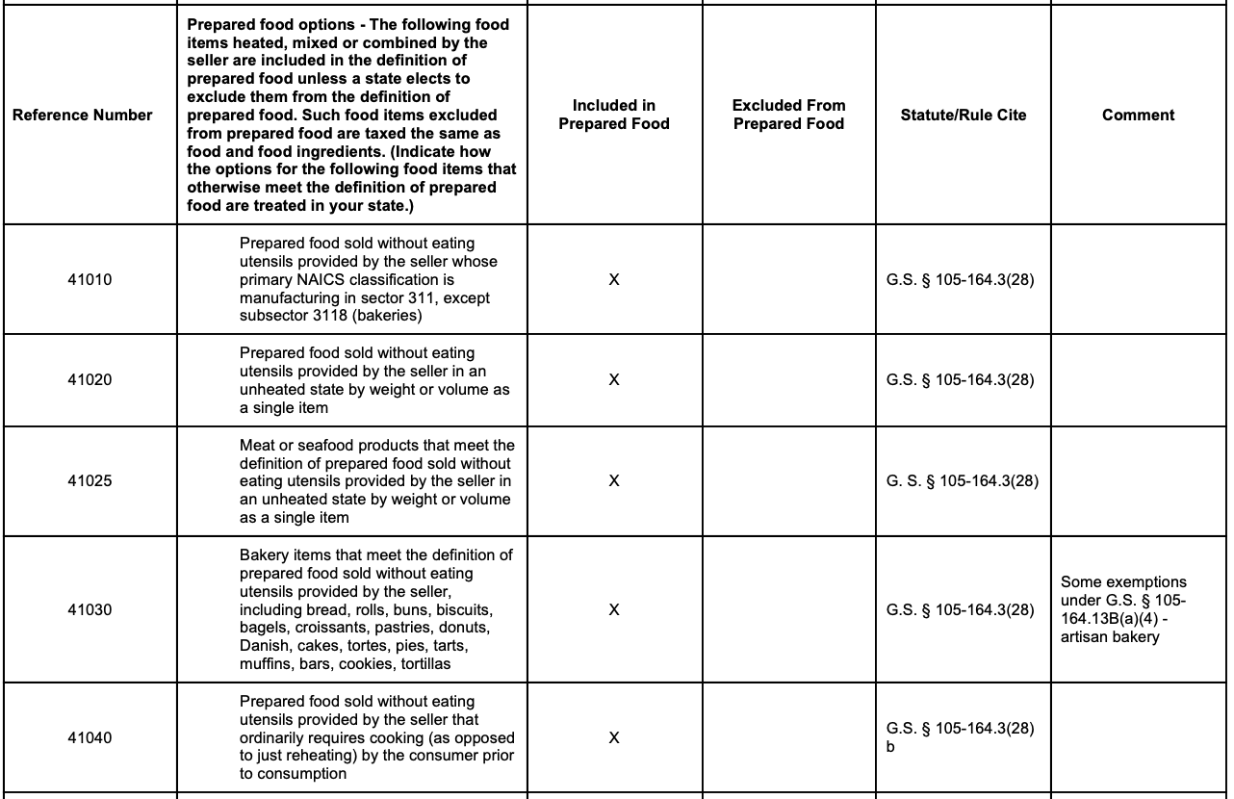


Prepared Food
Additional guidance

Slide 16
Sales Tax and MEAT
Live animals: exempt from tax when sold by producer [G.S. 105-164.13(4b)]
Cuts of meat (uncooked): subject to 2% rate on food sold by producer or retailer.
Processed meat: (e.g. uncooked sausage) subject to 2% rate on food sold by producer or retailer.
Cooked/smoked meat: subject to 4.75% State and applicable local sales tax.

Slide 17
Sales of Fruits and Vegetables
Raw vegetables sold by a producer are exempt [G.S.105-164.13(4b)]
Raw veggies that are cut up and placed in bags to be sold by producer are exempt.
Shelled butter beans or corn sold in plastic bags by producer are exempt.
If the producer adds anything to the vegetables such as seasoning, no longer exempt, subject to 2% tax on food.
Veggies or fruit sold by retailer, subject to 2% tax rate on food
Fruits and veggies that qualify as a prepared food (jams and jellies) item are subject to 4.75% plus any local sales tax.
Raised cut flowers, honey and firewood sales are sales tax exempt.

Slide 18
Registering to Remit Sales and Use Tax
Online Registration (Generally Quickest)
  http://www.dor.state.nc.us/electronic/registration/index.html
Complete and Submit Form NC-BR
  http://www.dor.state.nc.us/downloads/forms_fillin_ncbr.php?url=fillin/NCBR_webfill.pdf

Slide 19
Farmer Input Exemption Certificate: Exempted Items
Pesticides
Baby chicks and poults
Commercially built facility and Building materials for raising or feeding of animals
Bulk tobacco barns, racks or accessories to cure or dry tobacco
Fuel and Electricity (separate meters)
Fertilizer, plastic mulch, seeds, lime, land plaster
Farm machinery, repair parts and lubricants
Containers
Grain, feed, soybean storage facility and parts

Slide 20
NC Sales Tax Exemption - Purchases
Tangible personal property, digital property, and services exempt from sales and use tax when purchased by a qualifying farmer for use in farming operations.
A qualifying farmer is a farmer who has
  an annual gross income for the preceding income tax year of ten thousand dollars ($10,000) or more from farming operations
  or who has an average annual gross income for the three (3) preceding income tax years of ten thousand dollars ($10,000) or more from farming operations.

Slide 21
NC Sales Tax Exemption – Purchases (cont’d)
An item is used in farming operations if it is used for the planting, cultivating, harvesting, or curing of farm crops or in the production of dairy products, eggs, or animals.
For new operations
  Gen. Stat. § 105-164.13E as rewritten allows certain persons engaged in farming operations that otherwise do not meet the definition of the term “qualifying farmer” to apply for a conditional farmer exemption certificate
Google: Form E-595QF, Application for Qualifying Farmer Exemption Certificate Number for Qualified Purchases

Slide 22
New Farm - Conditional Farmer Exemption Certificate (Form E-595CF)
A conditional farmer exemption certificate (CF) issued by the Department is valid for the income tax year in which the certificate is issued and the following two income tax years
A person issued a CF must submit the required documentation to the Department within 90 days following the end of each income tax year covered by the CF.
A conditional farmer exemption certificate may not be extended or renewed beyond the original three-year period (must file E-595CF if qualify)
Fifteen year bar on new CF application

Slide 23
Conditional Farmer Exemption Certificate – Strict Requirements
CF holder must maintain documentation of the items purchased and copies of State and federal income tax returns that reflect activities from farming operations for the period of time covered by the CF and for three years following the expiration of the CF
NCDOR may require a person who was issued a CF number to provide any other verification information
Failure to provide the information requested by NCDOR, or qualification failure in audit triggers liability for any taxes claimed as exempt, immediately due and payable with interest.
Additionally, where the person does not timely provide the information requested by the Department, the $250.00 misuse of exemption certificate penalty applies to each seller identified by the Department from which the person made a purchase

Slide 24
Employee Classifications
Issue: obligation to pay employment taxes
Employee vs. Contractor
  Employee (required to pay ESC, FUTA, SUTA, etc.)
    Generally, if you provide direction, tools, time parameters, etc., classify as employee (I-9, etc.)
  Contractor (contract rate only)
    Generally, contractor provides own tools, schedule, etc.
Unpaid Intern vs. Employee
  Unpaid Intern: must have association with education structure, generally non-profit
  Employee: business gets economic benefit
Pay your summer labor!

